Slide 1

Week 8
Raspberry Pi
Fundamentals of IoT
Dr. Eoin Rogers (eoin.rogers@tudublin.ie)

Slide 2
Lesson Outline
We’re going to introduce the full-size Raspberry Pi this week
Raspberry Pi programming with gpiozero
We’ll also review MQTT in preparation for this week’s lab!
We should have time to talk a bit about the lab at the end

Slide 3
Raspberry Pi
A single-board computer, but very unlike the Pico!

Slide 4
Raspberry Pi 5 specs
2.4 GHz 64-bit Arm processor (Broadcom SoC with 4 Cortex-A76 cores)
800 MHz GPU
4 or 8GB of RAM
USB, Wifi, Gigabit Ethernet, support for OpenGL and Vulkan
But no built-in secondary storage (we have SD cards, can also boot over the network or USB)

Slide 5
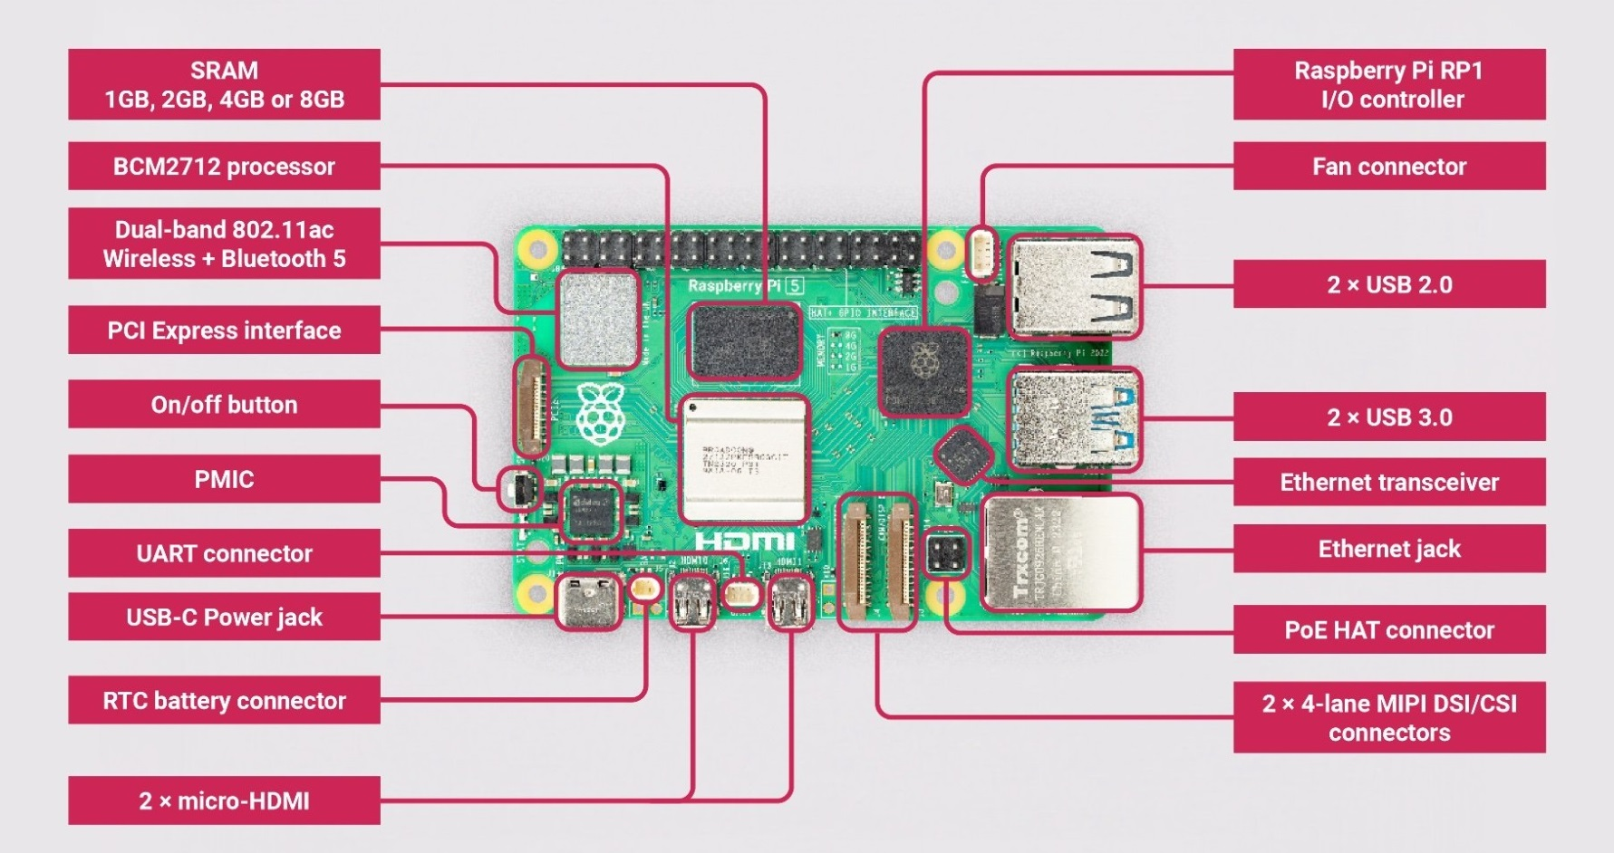
Raspberry Pi 5 diagram

Slide 6
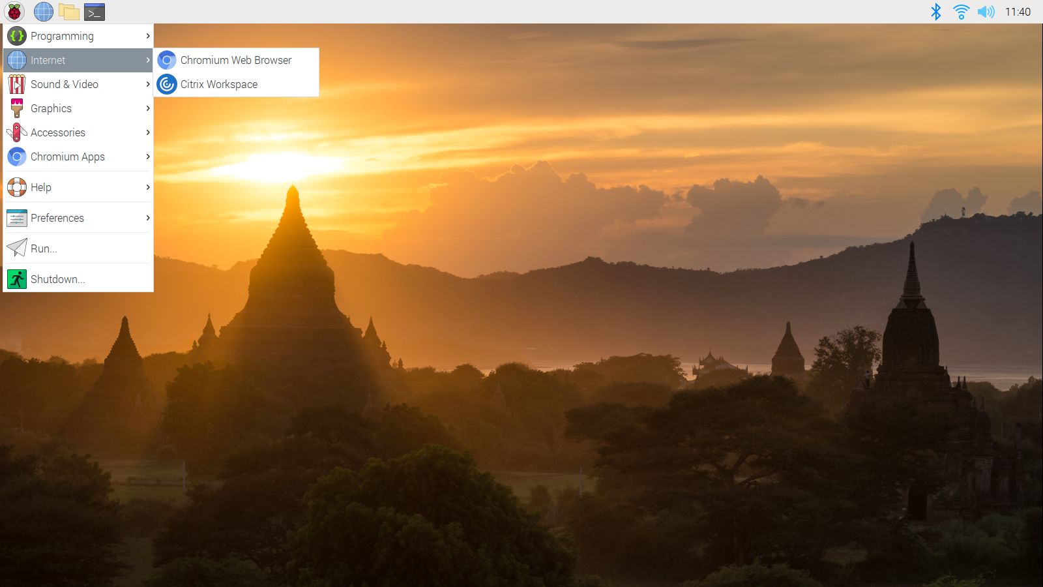
It runs Linux!

Slide 7
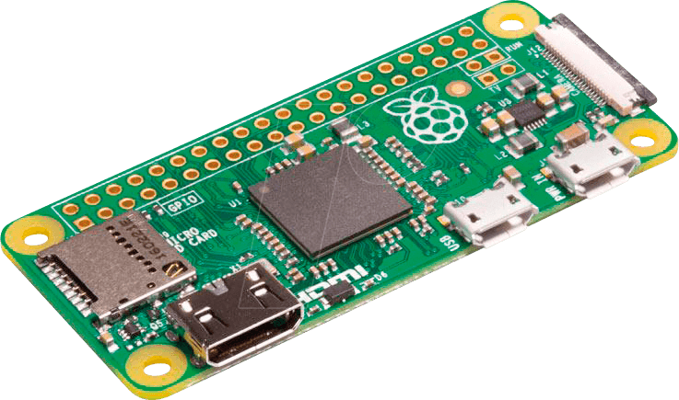
Raspberry Pi Zero

Slide 8
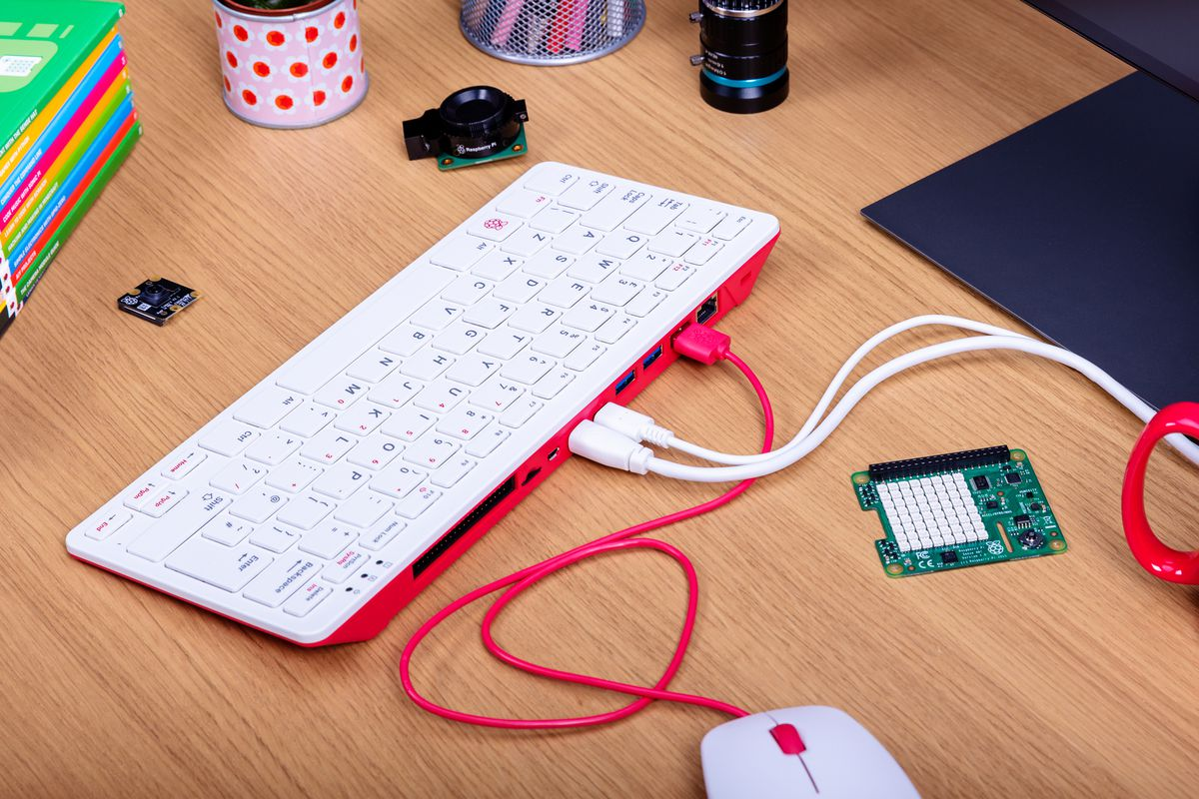
Raspberry Pi 400

Slide 9
GPIO on the Raspberry Pi
The Pi’s GPIO facilities are similar to the Pico’s

Slide 10
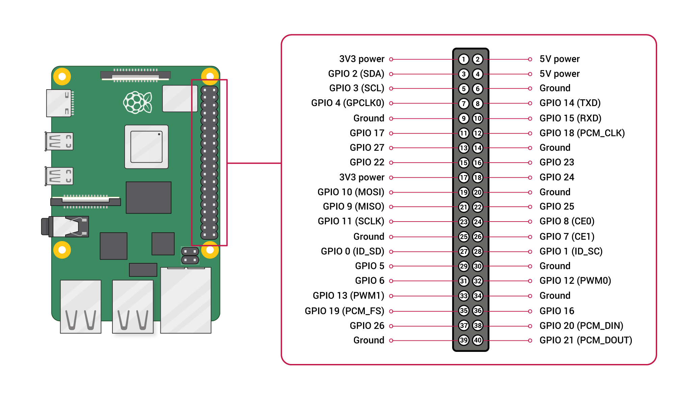
Raspberry Pi GPIO pinout
Note the distinction between the Broadcom and Board naming schemes – this is important!

Slide 11
Libraries
A number of GPIO libraries exist for the Pi, and support a wide range of languages
The actual GPIO is controller from userspace via ioctls into a kernel module
Both low-level and high-level APIs have been implemented on top of this for a range of languages

Slide 12
gpiozero
Very easy to use Python GPIO library

Slide 13
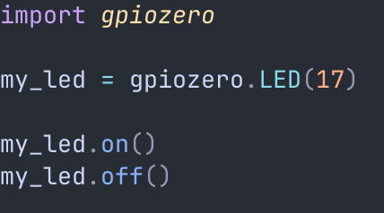
Controlling an LED

Slide 14
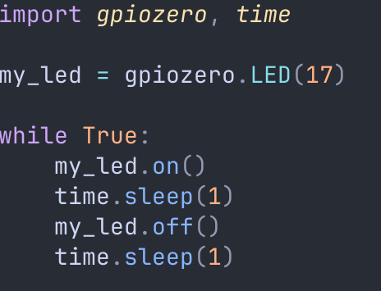
Blinking an LED

Slide 15
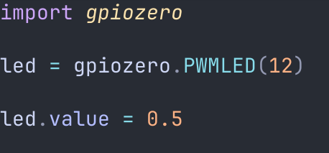
PWM LED control

Slide 16
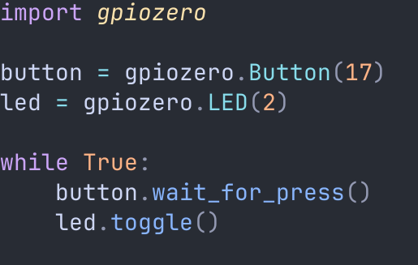
Toggle an LED with a button

Slide 17
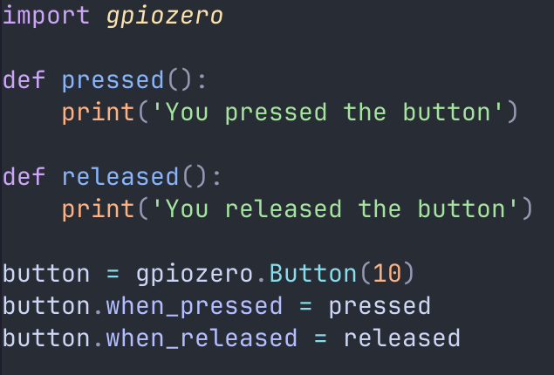
Callbacks for hardware events

Slide 18
MQTT overview
You’ll need to understand MQTT for the lab, so let’s review it!

Slide 19
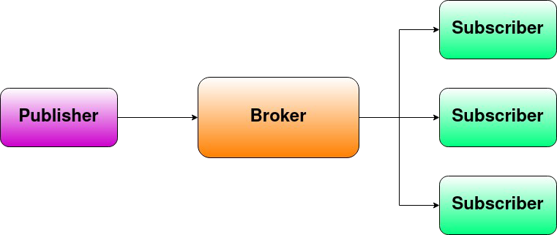
MQTT

Slide 20
Motor controller
A device used to control an electric motor

Slide 21
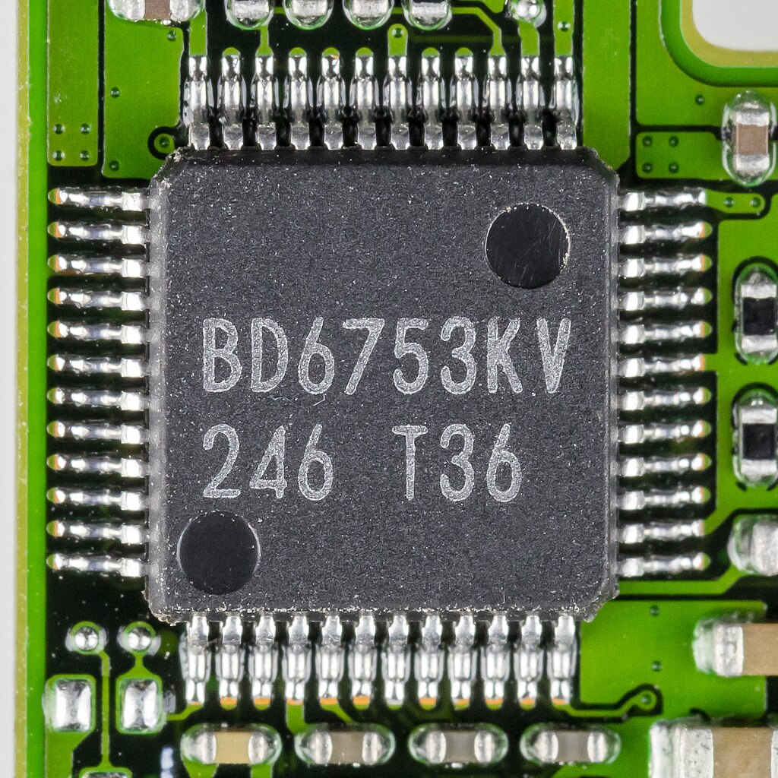
Motor controller
A device to control an electric motor. For example, the one shown to the left is used to control the lens of a digital camera. Why might we need such a device? Why not wire the motor directly to the GPIO pins? Where have we seen a motor controller before?

Slide 22
Summary
Introduced the Raspberry Pi
Gave you a taste of programming the GPIO facilities. All other types of programming are the same as on a normal PC or laptop: it is just an ordinary computer running Linux!
Reviewed about MQTT
Introduced motor controllers, a new type of component, which is a device that controls one or more electric motors

Slide 23
<number>
That’s all for this week
Thanks for your attention!

